Slide 1
National HIV POCT Site and Personnel Certification Data Flow and Tools

Slide 2


Overview of National HIV Certification Program (one certification entity)
National POCT Certification Program (MOH)
Site certification program
Tester certification program
Site Audit Tools
● SPT-RT checklist
(Paper & Tablet-ODK Collect)
Site Data Management Tool
● ODK Aggregate
Competency Data Management Tool
● Excel spreadsheet
Competency Assessment Tools
● Written exam package
- paper based package
- Siemens PEPconnect Solution
● Practical exam package
Certification Dashboard
Site Module
Personnel Module
Notes:
The Permanent Secretary has approved the framework for the National POCT Certification Program to ensure efficient and effective programming that guarantees reliability and accuracy of test results as well as encourage a culture of continuous quality improvement for the program.
This diagram shows the 2 main programs of certification that the framework governs: The Site Certification Program and the Tester Certification Program
When RTCQI was initially rolled-out in 2015, there was a training for the auditing component of Site Certification using SPI-RT, a scale up of an auditors training in March 2018, and many of you were certified and serve as POCT site auditors to help evaluate and assist sites achieve level 4 certification.
So today we are here to focus on training for the Tester Certification program, ultimately, to ensure ongoing monitoring and evaluation of testing personnel and assist personnel with becoming certified and maintaing their certification for HIV POCT.
Similar to the Site Certification program the Tester Certification program uses data management and competency assessment tools, which we will focus on learning how to use today.
Competency assessment tools include a written exam package and a pratical exam package
The written exam package may be administered in paper-based form or online using the Siemens PEPconnect Solution
Currently data can be managed using the excel spreadsheet template, but the CDC ILB informatics team is working on programming a Personnel module of the Certification Dashboard that will be accessible via internet and help to automatically generate analyses of the personnel certification data, similar to the site module that already exists for Site Certification.
We hope to have the Personnel module ready by March and will need to collect names of sites, testers and geographic areas of sites to pre load into the system.

Slide 3
Tester Personnel Training and Certification Process
National certification
Refresher Training
Initial Training
or
National HIV RT Training Package
(MOH, NRLs)
  Formal 1-2 day refresher training
  Mentoring/coaching
    Site supportive supervision visit
    Project ECHO
  Targeted training
    RT-CQI training program
    Siemens refresher training video
Competency assessment tools
  MOH tools
  CDC/CLSI package
  Siemens (Personalized Education Plan) PEPConnect & assessment questions
Notes:
This slide shows the overall HIV Tester Personnel Training and Certification Process
The overall training and certification process starts with a training and then competency assessment to lead to certification
The MOH will develop the training curriculum
There will be an initial training for new testers and a refresher training that must be taken by tester’s to maintain their competency.
Refresher training may be administered through a formal 1-2 day refresher training, mentoring/coaching or targeted training
The Siemens PEPconnect platform that we will discuss in a later session today has a educational video that can be viewed online from desktop or mobile device.
It also provides an competency assessment exam, as I mentioned before) that automatically generates a set of 25 questions for a question bank of 180.

Slide 4


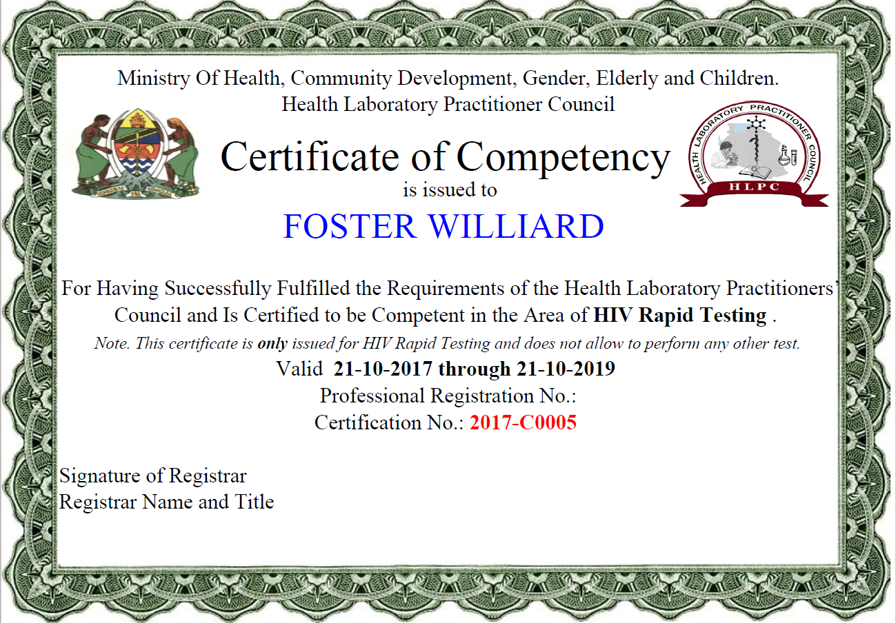

2 Types of Tester Certification Process Flow Paradigms (Example 1)
Offline Competency Package
Questions selected from 9 RTCQI testing areas to arrive at
Final written exam score
Written Exam
OR
Manual entry of competency results in central database in Excel or Dashboard
(District/Region)
Registration of tester
(District or Region)
Personnel Certification Program
Siemens PepConnect
Panel or Client testing score
+
Documentation score
Practical exam
Notes:
Examinee can take Written Exam or Practical exam 1st , then take the other exam subsequently

Slide 5
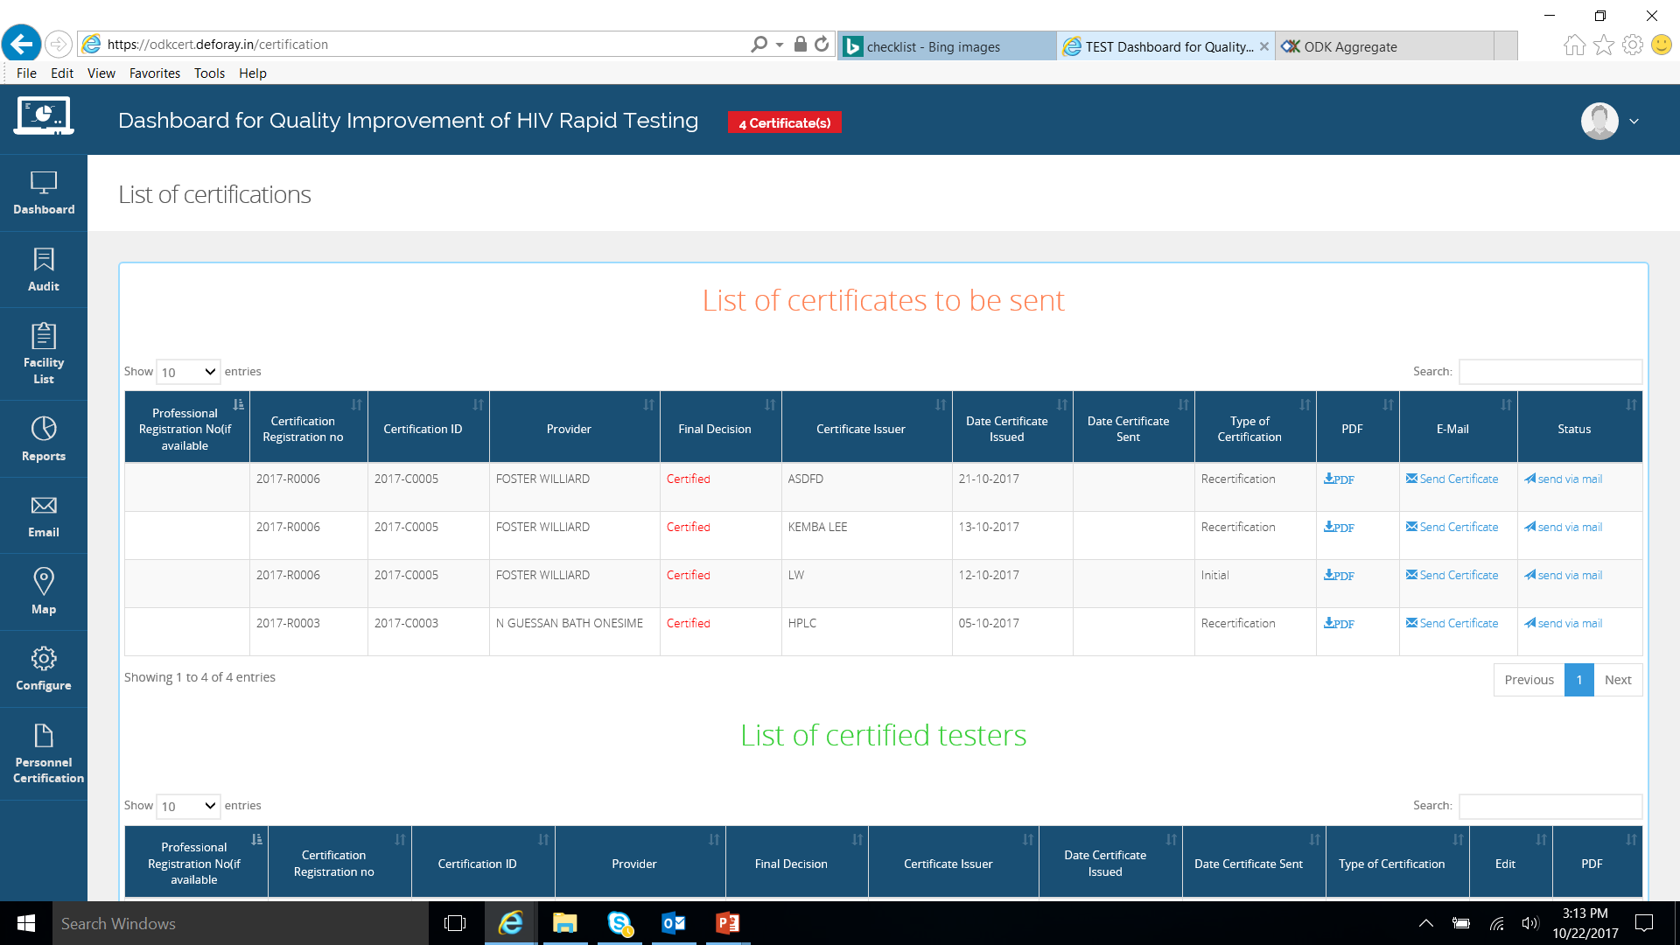
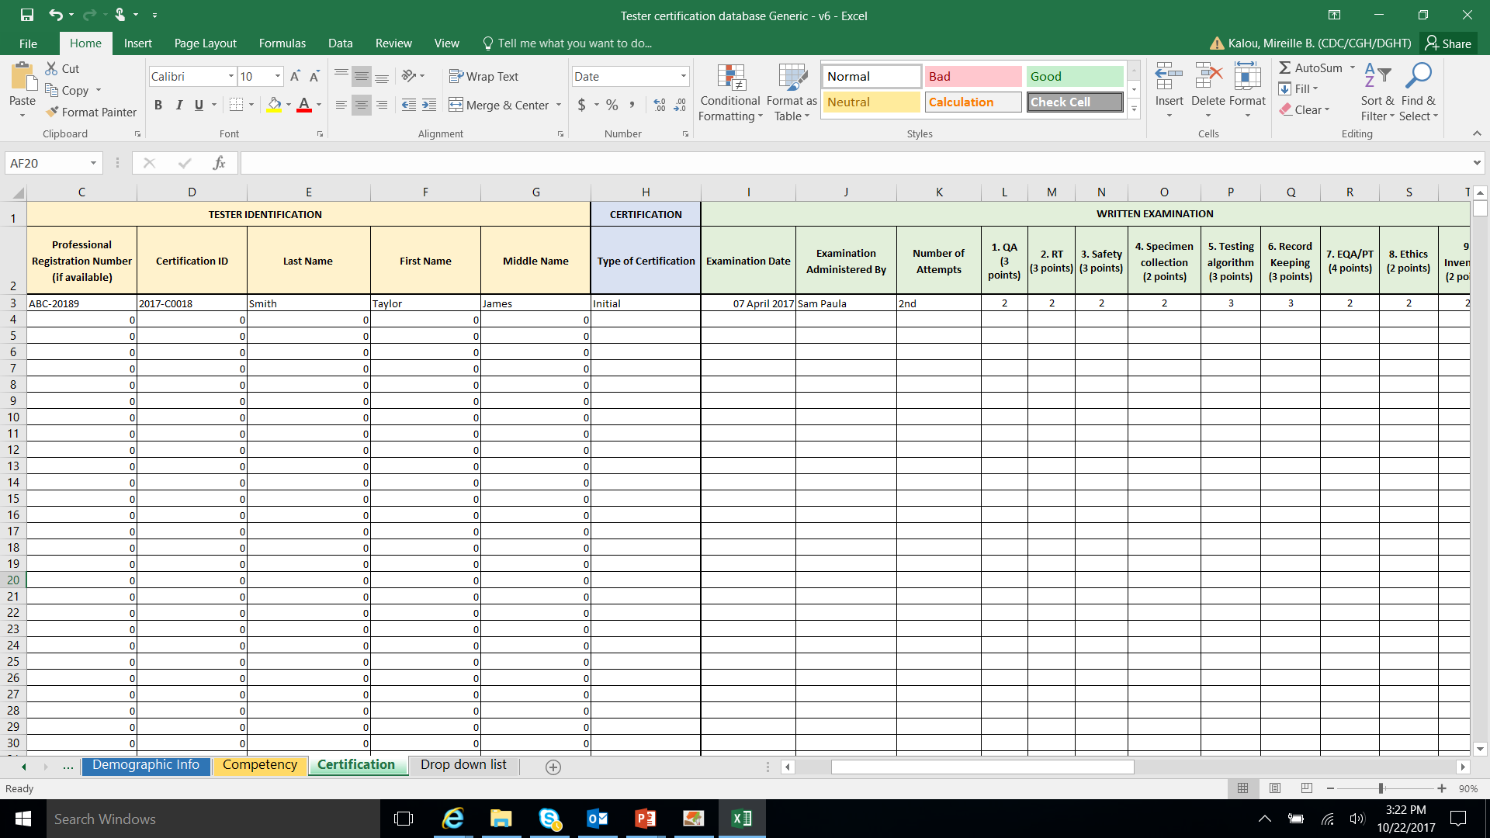
2 Types of Tester Certification Process Flow Paradigms (Example 2)
5. Competency results transmitted for final decision
(District /Region)
1. Registration of tester (District or Region)
6. Data review and Certificate generation (certifying body)
4. Manual entry of competency results in Excel database or Dashboard
(District /Region)
Registering and conducting competency exams
(District /Region)
2. Written Exam
(Managed by certifying body)
3. Practical exam
Notes:
Cyclic process flow where examinee has to pass exam before taking the practical exam.

Slide 6

Process Flow for Certifying Evaluators for Tester Certification Program
Tester certification Competency Package
Training review & 9 RTCQI testing areas score
Written Exam
Manual entry of competency results in central database
(Excel; District/Region)
Evaluator of POCT Personnel Competency
Direct Observation (by Facilitator) of Examinee evaluating Tester
Practical exam

Slide 7
Tester Competency Assessment Steps and Tools
Registering
Registration sheet
Generating written exam
Random question generator
Conducting written exam
Examination questions & Examination response sheets
Exam question code tracker
Questions bank
Steps
Document Tools
Excel spreadsheet or Certification Dashboard
Written Examination Questions & Answer Key
Competency panel (5-6 DTS specimens)
Practical Examination Result Form
Direct observation checklist
Excel spreadsheet or Certification Dashboard
Excel spreadsheet or Certification Dashboard
Conducting practical exam
Siemens PEPconnect Competency assessment
Managing the program
Certification SOPs & tools
Data Entry Databases
Siemens PEPconnect
Certification server
Informatic Tools
Notes:
This slide summarizes steps and tools that aid in tester competency assessment.

